Slide 1
Forecasting app

Slide 2
Purpose of the app
Company X can collect sales forecasts from customers to the app and distribute those forecasts forward to the suppliers to enable shorter lead times
Company X can also then calculate future sales values and budget for purchasing costs with different reports and graphs

Slide 3
Mockups / Functions
User interface is based on simililar kind of tool than excel where customer adds their forecast
Customer/product sales forecast in quantity
Customer | Product | Product description | Jan-22 | Feb-22 | Mar-22 | Apr-22 | May-22 | Jun-22 | Jul-22 | Aug-22 | Sep-22 | Oct-22 | Nov-22 | Dec-22
Customer 1 | P1 | Product1 |  |  |  |  | 10 |  |  |  | 10
Customer 1 | P2 | Product2 |  |  |  | 30 |  |  |  | 50
Customer 1 | P3 | Product3 |  |  |  |  |  |  | 40
Customer 2 | P4 | Product4 |  |  | 50
Customer 3 | P5 | Product5 |  |  |  |  | 1 |  |  |  |  | 1
Customer 4 | P2 | Product2 |  |  |  | 30 |  |  |  | 30
Customer 5 | P1 | Product1 |  |  |  |  |  |  |  |  | 10 |  |  | 10
User can then visualise forecast per product group or per product
Sales forecast per product group/product in quantity
Product group | Product | Product description | Jan-22 | Feb-22 | Mar-22 | Apr-22 | May-22 | Jun-22 | Jul-22 | Aug-22 | Sep-22 | Oct-22 | Nov-22 | Dec-22
A | P1 | Product1 |  |  |  |  | 10 |  |  |  | 20 |  |  | 10
A | P2 | Product2 |  |  |  | 60 |  |  |  | 80
B | P3 | Product3 |  |  |  |  |  |  | 40
B | P4 | Product4 |  |  | 50
C | P5 | Product5 |  |  |  |  | 1 |  |  |  |  | 1

Slide 4
Mockups / Functions
User can calculate supplier forecast for each item per shipping time and sourcing ratio to give correct quantity and timing for the supplier
Sales forecast per supplier/product in quantity
Supplier | Product | Product description | Sourcing ratio | Lead time for shipping in days | Jan-22 | Feb-22 | Mar-22 | Apr-22 | May-22 | Jun-22 | Jul-22 | Aug-22 | Sep-22 | Oct-22 | Nov-22 | Dec-22
Supplier1 | P1 | Product1 | 70 % | 60 |  |  | 7 |  |  |  | 14 |  |  | 7
Supplier1 | P1 | Product1 | 30 % | 30 |  |  |  | 3 |  |  |  | 6 |  |  | 3
Supplier2 | P2 | Product2 | 100 % | 60 |  | 60 |  |  |  | 80
Supplier3 | P3 | Product3 | 100 % | 30 |  |  |  |  |  | 40
Supplier4 | P4 | Product4 | 100 % | 30 |  | 50
Supplier5 | P5 | Product5 | 100 % | 30 |  |  |  | 1 |  |  |  |  | 1

Slide 5
Mockups / Functions
User can create different reporting in the app
Customer/product sales forecast in value
Customer | Product | Product description | Customer price | Jan-22 | Feb-22 | Mar-22 | Apr-22 | May-22 | Jun-22 | Jul-22 | Aug-22 | Sep-22 | Oct-22 | Nov-22 | Dec-22
Customer 1 | P1 | Product1 | 30 |  |  |  |  | 300 |  |  |  | 300
Customer 1 | P2 | Product2 | 100 |  |  |  | 3000 |  |  |  | 5000
Customer 1 | P3 | Product3 | 3 |  |  |  |  |  |  | 120
Customer 2 | P4 | Product4 | 50 |  |  | 2500
Customer 3 | P5 | Product5 | 10000 |  |  |  |  | 10000 |  |  |  |  | 10000
Customer 4 | P2 | Product2 | 30 |  |  |  | 900 |  |  |  | 900
Customer 5 | P1 | Product1 | 100 |  |  |  |  |  |  |  |  | 1000 |  |  | 1000
 |  |  | Total | 0 | 0 | 2500 | 3900 | 10300 | 0 | 120 | 5900 | 1300 | 10000 | 0 | 1000
 |  |  | Cumulative total | 0 | 0 | 2500 | 6400 | 16700 | 16700 | 16820 | 22720 | 24020 | 34020 | 34020 | 35020
Sales forecast per product group/product in value
Product group | Product | Product description | Customer price | Jan-22 | Feb-22 | Mar-22 | Apr-22 | May-22 | Jun-22 | Jul-22 | Aug-22 | Sep-22 | Oct-22 | Nov-22 | Dec-22
A | P1 | Product1 | 30 |  |  |  |  | 300 |  |  |  | 1300 |  |  | 1000
A | P2 | Product2 | 100 |  |  |  | 3900 |  |  |  | 5900
B | P3 | Product3 | 3 |  |  |  |  |  |  | 120
B | P4 | Product4 | 50 |  |  | 2500
C | P5 | Product5 | 10000 |  |  |  |  | 10000 |  |  |  |  | 10000
 |  |  | Total | 0 | 0 | 2500 | 3900 | 10300 | 0 | 120 | 5900 | 1300 | 10000 | 0 | 1000
 |  |  | Cumulative total | 0 | 0 | 2500 | 6400 | 16700 | 16700 | 16820 | 22720 | 24020 | 34020 | 34020 | 35020
Sales forecast per supplier/product in value
Supplier | Product | Product description | Supplier price | Jan-22 | Feb-22 | Mar-22 | Apr-22 | May-22 | Jun-22 | Jul-22 | Aug-22 | Sep-22 | Oct-22 | Nov-22 | Dec-22
Supplier1 | P1 | Product1 | 10 |  |  | 70 |  |  |  | 140 |  |  | 70
Supplier1 | P1 | Product1 | 20 |  |  |  | 60 |  |  |  | 120 |  |  | 60
Supplier2 | P2 | Product2 | 50 |  | 3000 |  |  |  | 4000
Supplier3 | P3 | Product3 | 1 |  |  |  |  |  | 40
Supplier4 | P4 | Product4 | 20 |  | 1000
Supplier5 | P5 | Product5 | 3000 |  |  |  | 3000 |  |  |  |  | 3000
 |  |  | Total | 0 | 4000 | 70 | 3060 | 0 | 4040 | 140 | 120 | 3000 | 70 | 60 | 0
 |  |  | Cumulative total | 0 | 4000 | 4070 | 7130 | 7130 | 11170 | 11310 | 11430 | 14430 | 14500 | 14560 | 14560

Slide 6
Mockups / Functions
User can create different graphs in the app

Slide 7
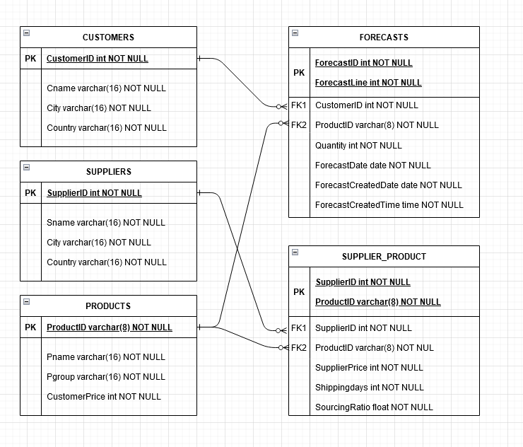
Schema

